Slide 1

Puberty
Year 7 Health – 2024
Lesson 11

Slide 2
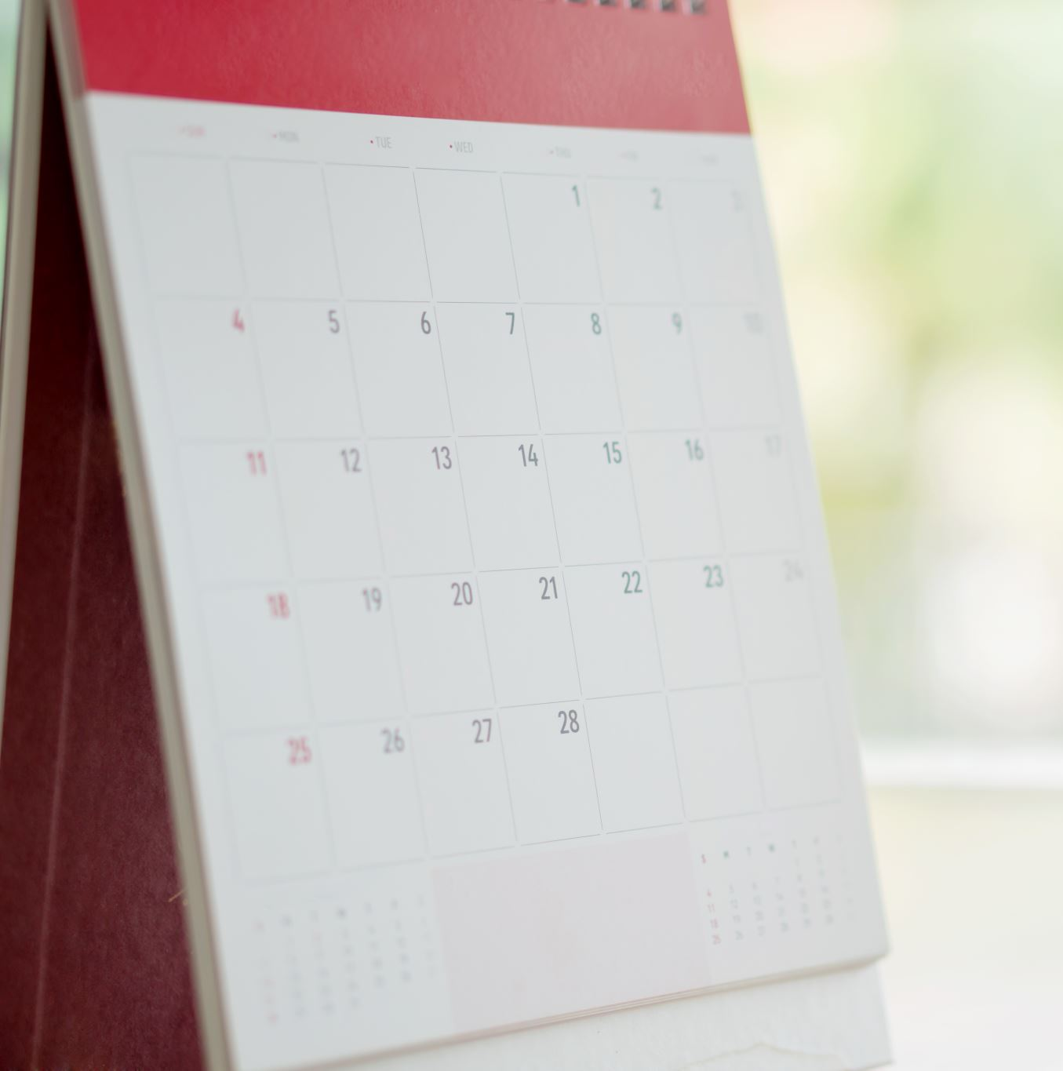
Today’s focus
Review KWL from first week of puberty.
Watch ’Inside Out’

Slide 3
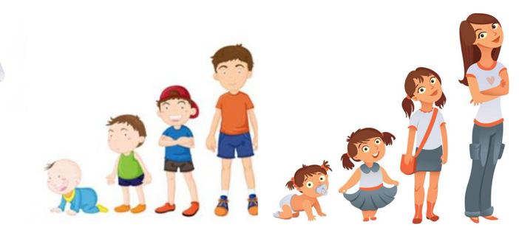
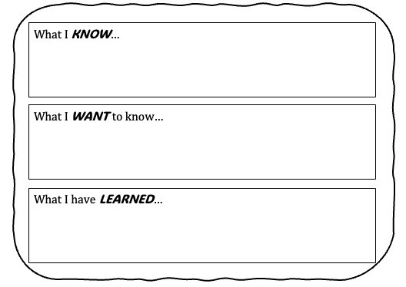
Puberty KWL REVIEW (pg.36)
Back in week 4, our first lesson on puberty, we completed a KWL
You completed the first two boxes of the KWL:
  What do you already know about puberty?
  What do you want to know about puberty?
Revisit your KWL and complete the last box:
  What have you learned throughout the puberty unit?
You have 5 minutes to reflect and write as much as you can in the box.

Slide 4

YOUR Questions Answered
Q:
A:
Q:
A:
Q:
A:
Q:
A:
Notes:
OPTIONAL – use this slide as a way of answering your question box questions during lessons.
Write the question, followed by the answer on the slide so students can read and follow along.

Slide 5
YOUR Questions Answered
Q:
A:
Q:
A:
Q:
A:
Q:
A:
Notes:
OPTIONAL – use this slide as a way of answering your question box questions during lessons.
Write the question, followed by the answer on the slide so students can read and follow along.

